Slide 1
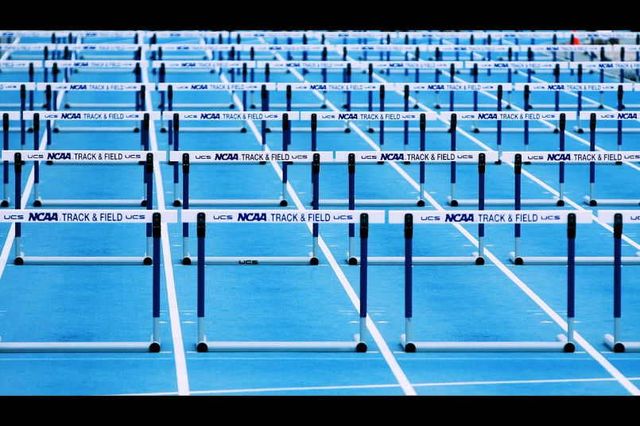
There are more than enough hurdles to achieving enterprise mobility …
What if integration came standard?
OSLC User Group for Mobile
It all starts with scenarios.
http://bit.ly/OSLC-UG-Mobile
Notes:
Image source: http://commons.wikimedia.org/wiki/File:Hurdles_%28Scenes_from_a_Track_Meet%29.jpg
Image creator: Phil Roeder (http://www.flickr.com/people/88876166@N00)

Slide 2
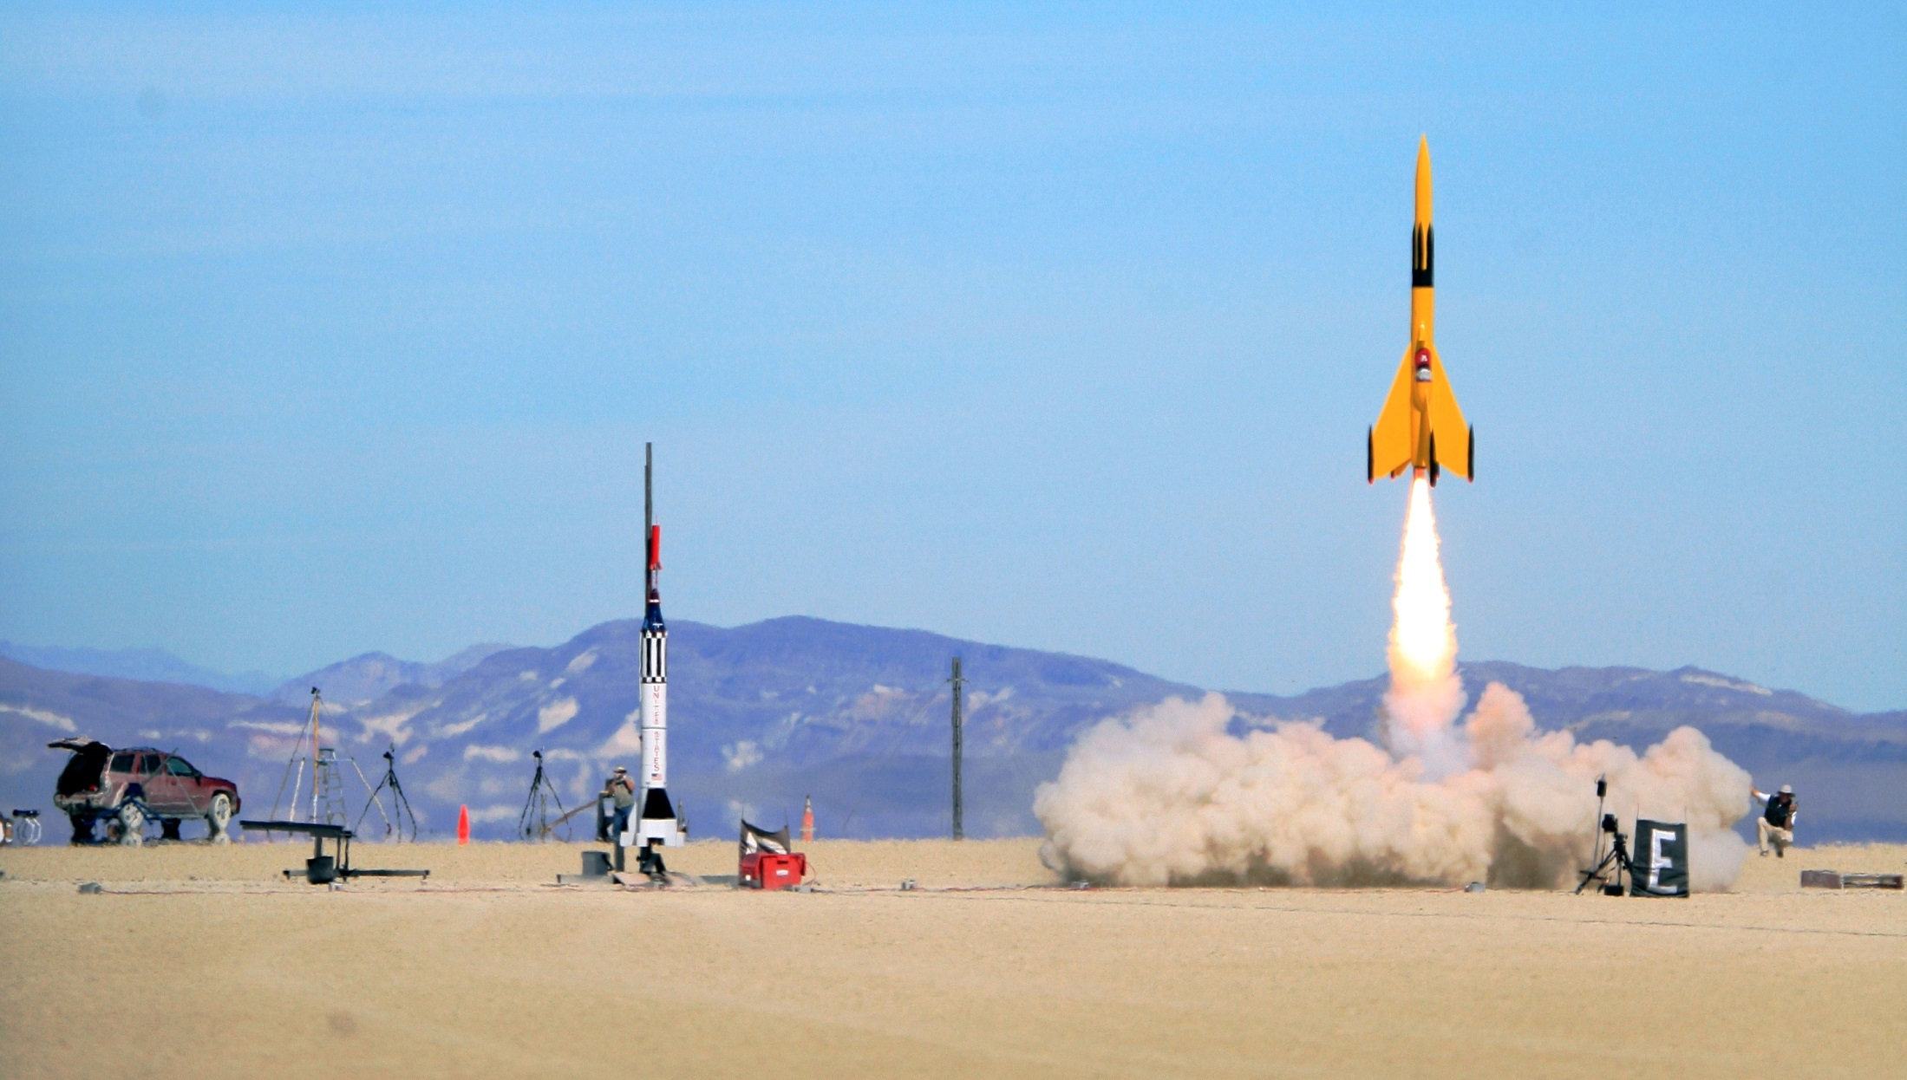
Rocket science is hard enough …
Shouldn’t integration come standard?
OSLC User Group for Embedded Systems
It all starts with scenarios.
http://bit.ly/OSLC-UG-EmbSys
Notes:
Image source:http://commons.wikimedia.org/wiki/File:Rocket.jpg
Image creator: Steve Jurvetson

