Slide 1
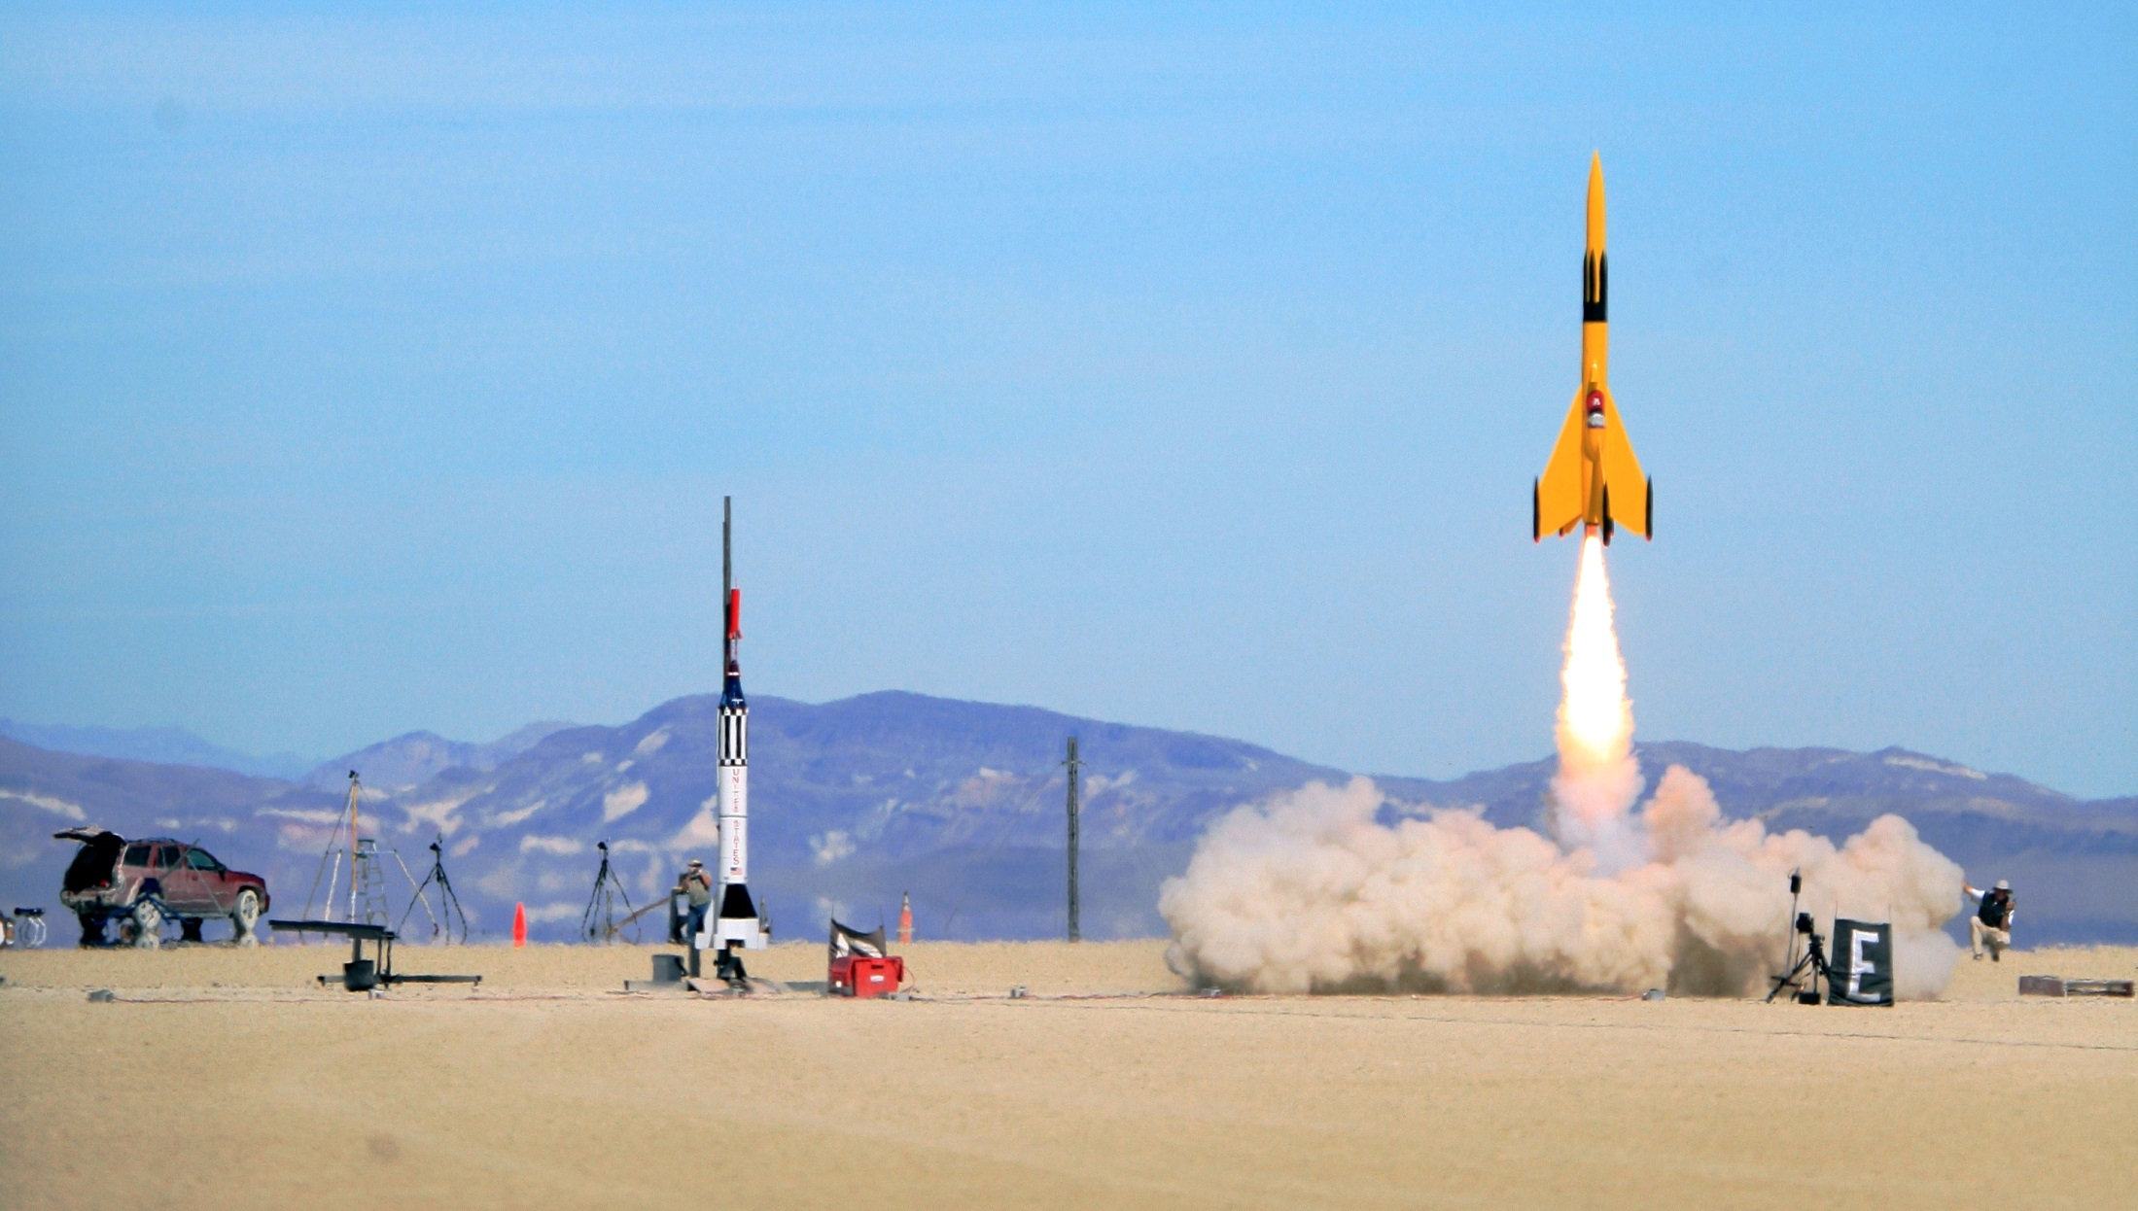
Rocket science is hard enough…
Shouldn’t integration come standard?
Join us! http://bit.ly/OSLC-UG-EmbSys
OSLC User Group for Embedded Systems
It all starts with scenarios.
Notes:
Image source:http://commons.wikimedia.org/wiki/File:Rocket.jpg
Image creator: Steve Jurvetson

