Slide 1
HSUV Example Change Scenario
Step by step discussion of how the requirements change scenario plays out in the example model
V7 15th Feb
1

Slide 2
The goal of this activity
To illustrate how the PLM Context is defined within a tool and PLM Reference Model today and how carried today by ALM tool and the current Specs

Slide 3
Storyboard idea
3
Tells the story from the CR being raised (in some tool(s)) to the Scenario #1 being completed (in some tool(s))
Narrative
Tool screen shots (or mock ups)
PLM Reference model highlights

Slide 4
Comments
The ALM and PLM activity to act upon a common object e.g. a requirement
Ideally show the stakeholders
  ? Re-use Rainer’s / Pascal’s example from Innovate 2010
Make swim lane example
  Multi-roles or tools

Slide 5
Preconditions
HSUV model including requirements and structure elements exists
Model elements are at initial versions
Model is fully “released”
  Locked so no edits can be done without creating a new version
5

Slide 6
PLM reference model
[Model] HSUVExample
[Package] HSUVExample
  [Test Case] SAE J1491 Max Acceleration
    [State Machine] SAE J1491
      SAE J1491
    SAE J1491
  [Block] AutomotiveDomain
    [Block] HybridSUV
      [Block] PowerSubsystem
        Alternative 1 - Combined Motor Generator id=AMG60107 version=001
        PowerControlUnit Breakdown id=AMG60107 version=001
        Fuel Flow Rate Determination
      [Block] PowerSubsystem
        Alternative 1 - Combined Motor Generator id=AMG60107 version=002
        PowerControlUnit Breakdown id=AMG60107 version=002
      [Block] PowerSubsystem
        Alternative 1 - Combined Motor Generator id=AMG60107 version=003
        PowerControlUnit Breakdown id=AMG60107 version=003
      PowerSubsystem Fuel Flow Definition
  HSUV Specification
  PowerSubsystem Breakdown id=AMG60104 version=001
  Automotive Domain Breakdown
  Acceleration Requirement Refinement and Verification
  Operational Use Cases
  PowerSubsystem Breakdown id=AMG60104 version=003
  PowerSubsystem Breakdown id=AMG60104 version=002
  Requirements Derivation
  HybridSUV Breakdown

Slide 7
Story 1 Step 1 – Change Requirements to 2016 ULEV
TCE REQ
Add Higher level context
TC UA
Marketing opens change request
  Need to change vehicle to meet 2016 ULEV standards
  Change request has problem item REQ-000144/A attached
  Change request has reference item AKY251614/001 attached (this is the context, unconfigured for this step)
Released REQ-000144/A is revised to begin work on version “B”
When version “B” is finished it is released, then next higher assembly (REQ-000181/A) is revised to include this new version, and released
  Same sequence for each level to the top of the requirements tree (AKY251614/001)
  Becomes /002 from the change
Postcondition – Released requirements context now has AKY251614/002, REQ-000181/B, REQ-000144/B, rest are not changed.
Requirements change occurs here
PLM or ALM
/001 Version 1
144 is a child of 181
7

Slide 8
OSLC PLM Reference Model
Pre-condition

Slide 9
The PLM Reference Model
Scenario pre-condition
Primary concerns
  CR – Change Request
  Req – Requirement
  Context – Product and System context e.g. classification, configuration, effectivity
  Implem – Product and System implementation in models and documents
CR
System or
product context
Req
Controlled config
Implem

Slide 10
HSUV Product structure view – pre-condition
AMG54556/001
  AKY251614/001 Requirements specification
    REQ-1..n/A…ZZZ
      Derived REQ-1..n/A..ZZZ
    REQ-000181/A
      REQ-000144/A
  AMGC60112/001 Implementation
    AMG60104/001 Power Sub-System

Slide 11
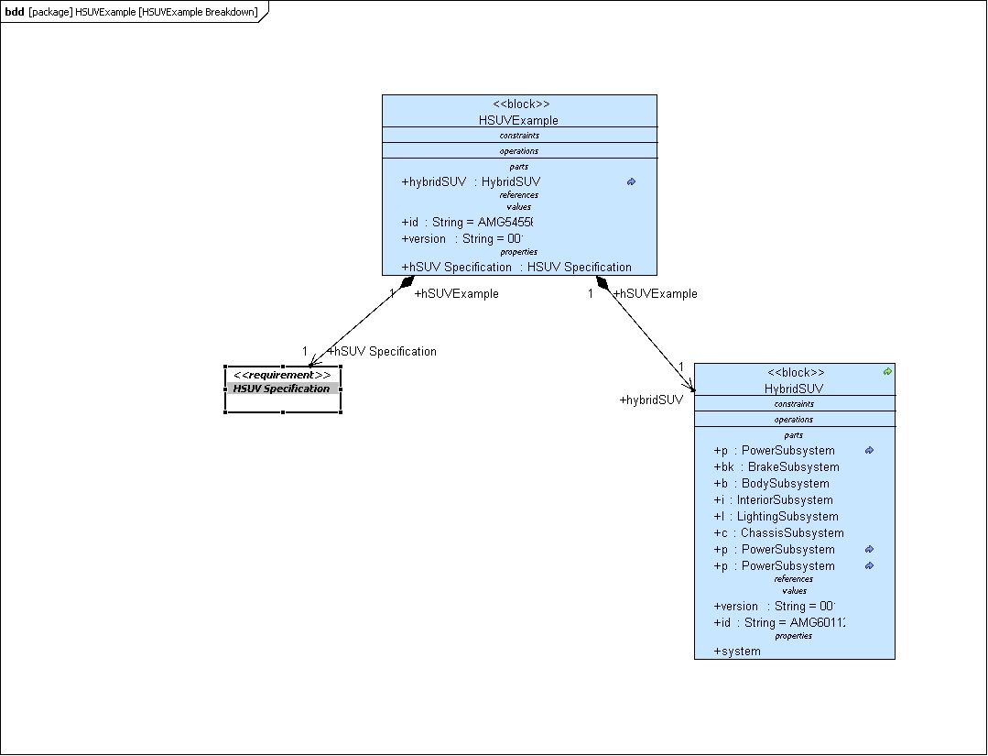
HSUV Example Systems breakdown diagram – pre-condition
Top level product context
AMG54556/001
Top level Req identity
AKY251614/A
Implementation
AMGC60112
Check /A

Slide 12
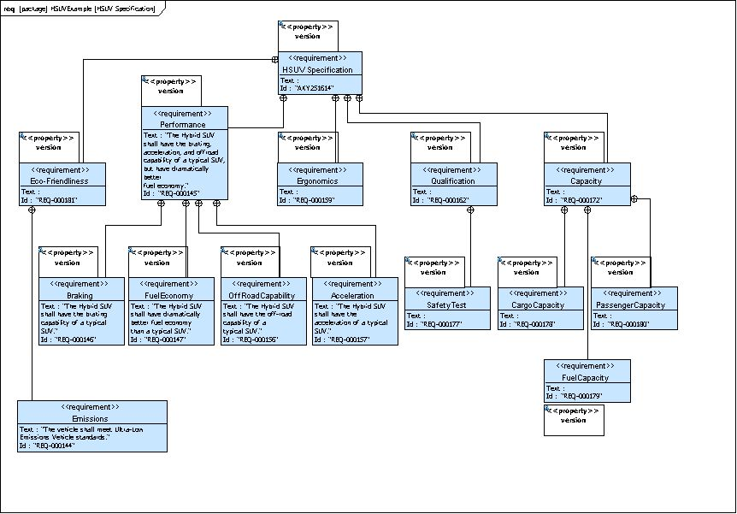
HSUV Specification Requirements diagram pre-condition for AKY251614/001
Top level Req context
AKY251614/A
Hosting requirements
REQ-000181/A
Subject of the CR
REQ-000144/A

Slide 13
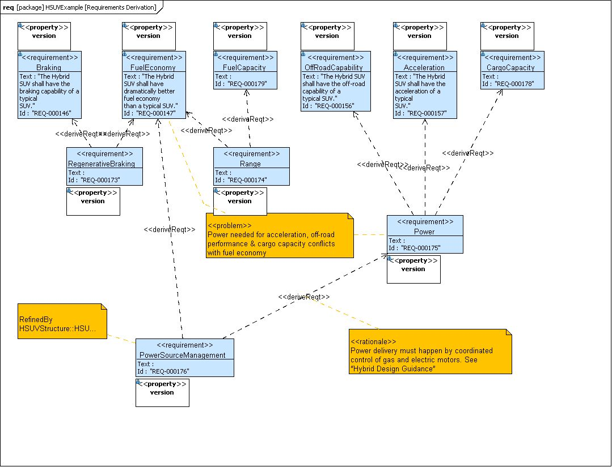
HSUV Specification Requirements derivation diagram pre-condition for AKY251614/001
Does this play any part in the scenario today ?

Slide 14
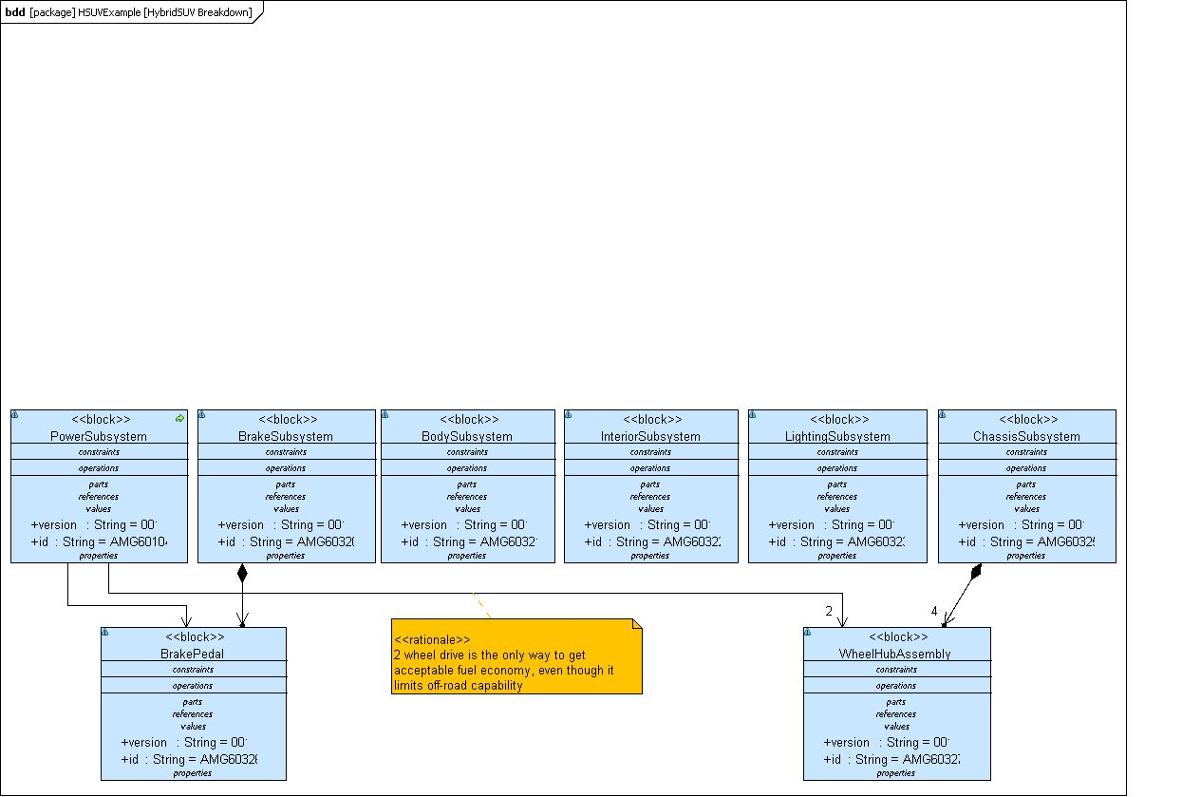
HSUV system breakdown AMGC60112/001 pre-condition
Check right id
Power sub-system AMG60104/001

Slide 15
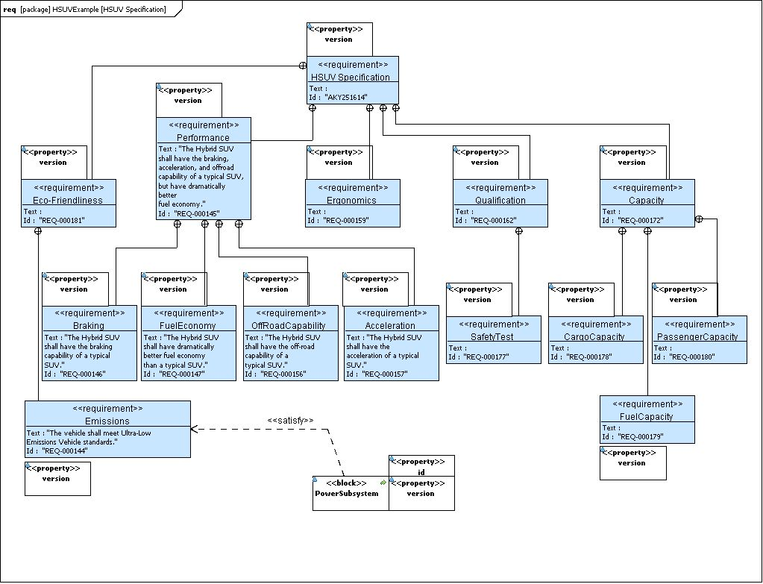
HSUV Specification Requirements package diagram pre-condition for AKY251614/001 and key implementation relationship
REQ-000144/A is satisfied by Power sub-system AMG60104/001

Slide 16
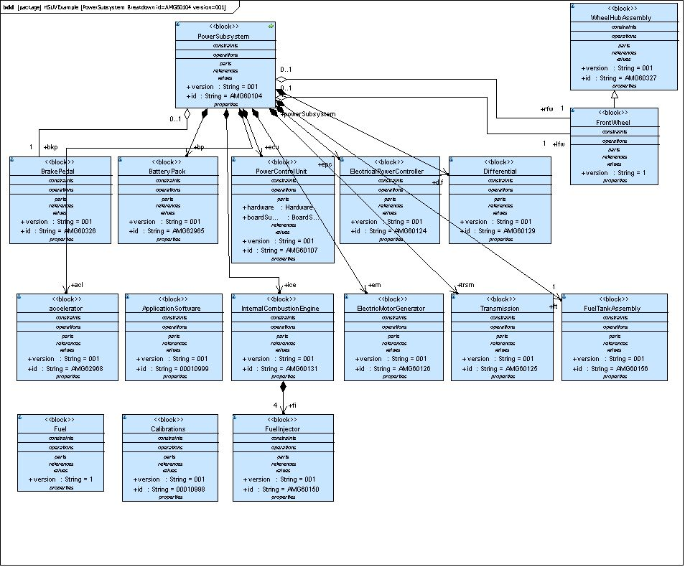
HSUV Power Sub-system bdd diagram pre-condition for AMG60104/001 which satisfies AKY251614/001
Power sub-system AMG60104/001 satisfies REQ-000144/A is satisfied by
Power Control Unit AMG60107/001 is the key component (ECU) to realise REQ-000144/A

Slide 17
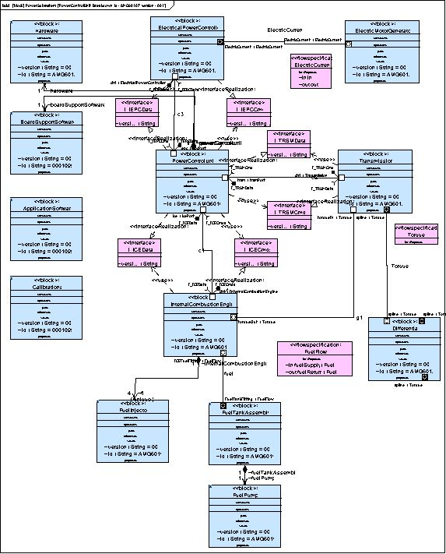
HSUV Power Control Unit bdd diagram pre-condition for AMG60107/001 which is the ECU for AMG60104/001
Power Control Unit AMG60107/001 is the key component (ECU) to realise REQ-000144/A
Power Control Unit AMG60107/001 has 3 key SW components

Slide 18
Not currently used in the scenario
Diagram Automotive Domain breakdown
Diagram Operational Use cases
Diagram Requirements Derivation
Diagram Power Subsystem Fuel Flow Definition
Diagram SAE J1491
HSUV Combined Motor Generator ibd diagram
Check

Slide 19
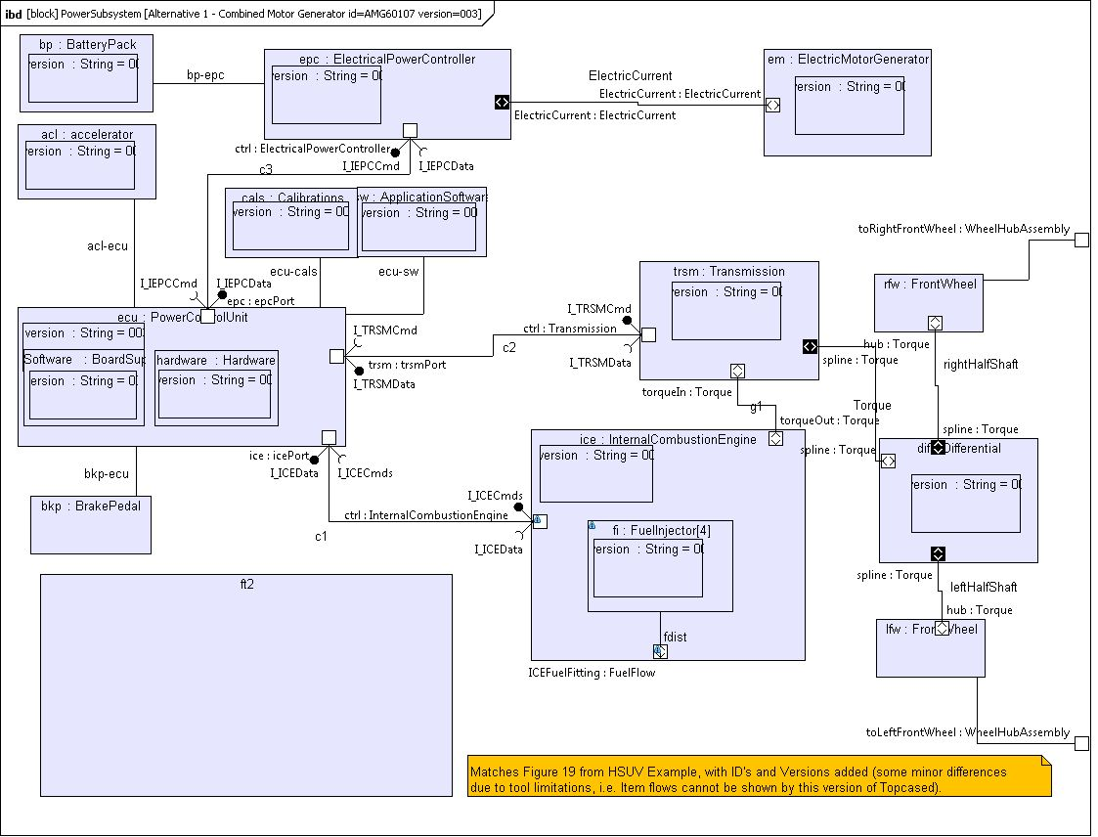
HSUV Combined Motor Generator ibd diagram pre-condition for AMG60107/001 which is the ECU for AMG60104/001
Power Control Unit AMG60107/001 hosts the Software
Power Control Unit AMG60107/001 hosts the Software
Clarify

Slide 20
Change scenario flow
Activity diagram shown with swim lanes for ALM and PLM “system”

Slide 21
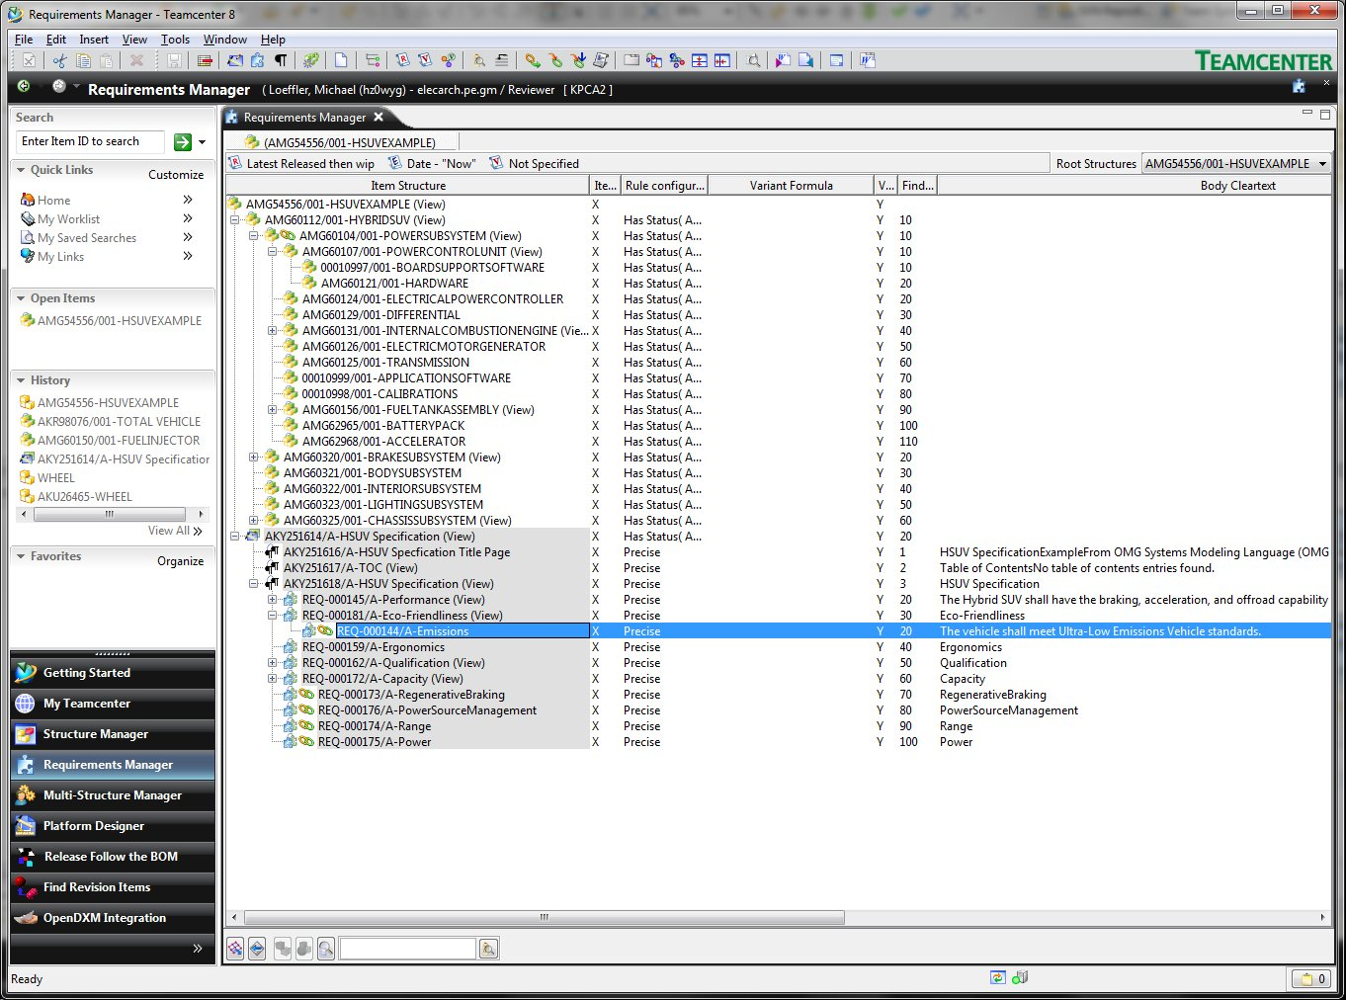
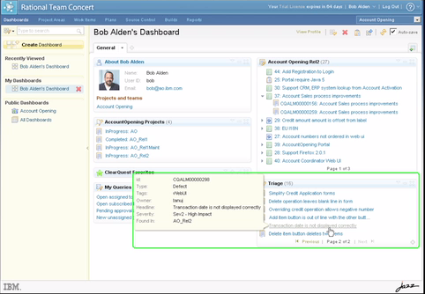
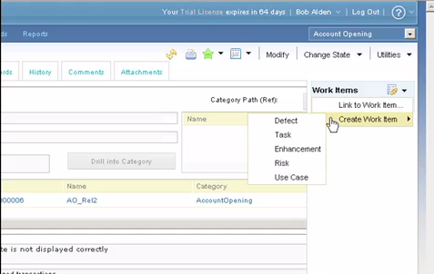
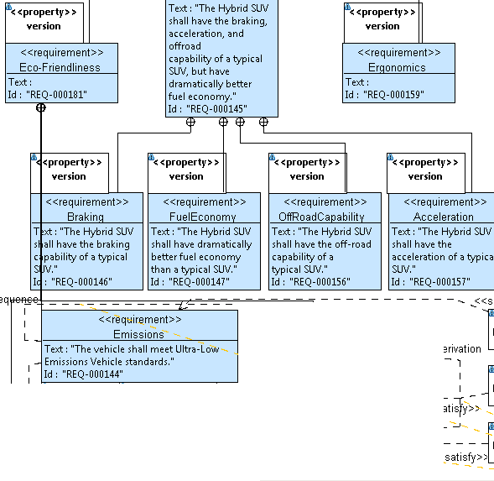
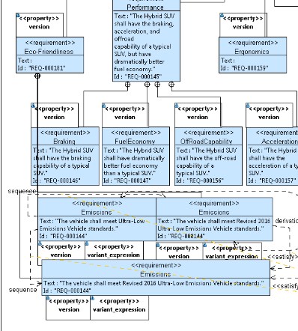
Change Requirements to 2016 ULEV
Mock up – Story 1 Step 1-1
PLM
Analyse
the CR
Check out
for Req change
ALM
Optional: Can be created ahead & assigned
See new
Work Item
Update
requirement
Revise + Add
Pre-condition
New revision
New revision
– changes added & new context
Ref model
REQ-000144/A

Slide 22
Change Requirements to 2016 ULEV
Mock up – Story 1 Step 1-1
PLM
Analyse
the CR
Check out
for Req change
ALM
See new
Work Item
Update
requirement
Pre-condition
New revision
New revision
– changes added & new context
Ref model
REQ-000144/B
15-Feb-11
OSLC PLM working group
22

Slide 23
Check out REQ-000144/A > REQ-000144/B
Eco-Friendliness Req REQ-00181/A
Subject of the CR
REQ-000144/B

Slide 24
Change Requirements to 2016 ULEV
Mock up – Story 1 Step 1-1
PLM
Analyse
the CR
Check out
for Req change
ALM
See new
Work Item
Update
requirement
Pre-condition
New revision
New revision
– changes added & new context
Ref model
REQ-000144/B
15-Feb-11
OSLC PLM working group
24

Slide 25
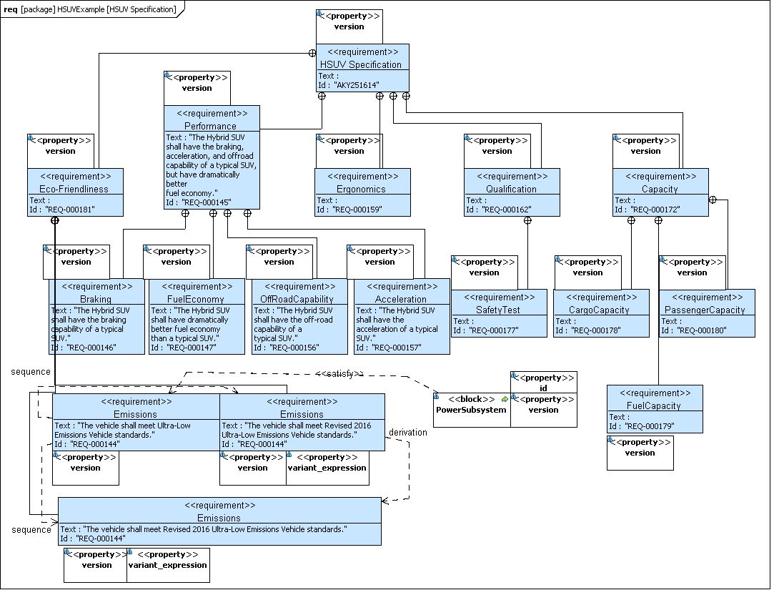
REQ-000144/B built out with alternative effectivity based upon Region=US, Emissions=ULEV
REQ-000144/B

Slide 26
Change Requirements to 2016 ULEV
Mock up – Story 1 Step 1-2
PLM
Define new
context
Check in
from Req change
Revise next level assy
ALM
Complete
work item
Requirements: New revision
Context: Assigned to new requirements
Implementation: Old
Ref model

Slide 27
REQ-000181/A > Revision B
REQ-000181/B

Slide 28
HSUV Product structure view
– Story 1 Step 1 post -condition
AMG54556/001
  AKY251614/A Requirements specification
    REQ-1..n/A…ZZZ
      Derived REQ-1..n/A..ZZZ
    REQ-00181B
      REQ-000144/B
        Alternative 1 - Eu
        Alternative 2 - US
  AMGC60112/001 Implementation
    AMG60104/001 Power Sub-System
Check /002 ?

Slide 29
Workings

Slide 30
Pre
Post
Diagram as-is
  Increment of versions
    B
    002
    (Cant show easily in the diagram
    (Properties
      Cant be displayed

Slide 31
Story 1 Step 2 – Change Design to Meet Revised Requirements
“Problem” = Affected items
Current context of the Implementation
Original change request remains open, related structure items must be fixed to meet the revised requirement
  Follow the <<satisfy>> link from REQ-000144/A to find PowerSubsystem AMG60104/001, add it to the list of problem items on the change request, add the top level HybridSUV (AMG60112/001) item as reference
  Revise released AMG60104/001 to version 002 and begin changes to meet new requirement
  Create new versions of PowerControlUnit, FuelTankAssembly, ApplicationSoftware and Calibrations to meet new requirement
    Attach each original version to the change request as problem items (NOTE: This could have been done when the initial change request was created by following the links from the requirement that was attached)
    Attach the revised versions as solution items
    NOTE: ApplicationSoftware and Calibrations should probably be further decomposed and the change should roll down to internal items inside them, such as a specific version of a specific software component, etc. to illustrate the ALM connectivity to the context
  Release all the new versions, replace original versions in AMG60104/002 and release it
  Change top level HybridSUV assembly (context) to include new PowerSubsystem version and release it
Close the change request as complete
  This step may be automatic based on how the change request system is configured to handle closing of the change based on release of the solution items.
PLM or ALM
2
Add Higher level context to tie AMG60104/001 to AKY251614/001 – Done in V12
3
3
Example of a ALM activity
Example of a PLM activity
3
PLM
PLM/ALM Either or split
Assume complete this CR then release the higher level assembly
31

Slide 32
Change Design to Meet Revised Requirements
Mock up – Story 1 Step 2-1
PLM
Check out for
design change
Check in
from Dsgn change
ALM
See new
Work Item
Update
implementation
Complete
work item
Requirements: New revision
Context: New assigned
Implementation: Old
Requirements: New revision
Context: New assigned
Implementation: New
New design
revision
Ref model

Slide 33
PLM reference model
[Model] HSUVExample
[Package] HSUVExample
  [Test Case] SAE J1491 Max Acceleration
    [State Machine] SAE J1491
      SAE J1491
    SAE J1491
  [Block] HybridSUV
    [Block] PowerSubsystem
      PowerControlUnit Breakdown id=AMG60107 version=001
      Fuel Flow Rate Determination
      Alternative 1 - Combined Motor Generator id=AMG60107 version=001
    [Block] PowerSubsystem
      Alternative 1 - Combined Motor Generator id=AMG60107 version=002
      PowerControlUnit Breakdown id=AMG60107 version=002
    [Block] PowerSubsystem
      Alternative 1 - Combined Motor Generator id=AMG60107 version=003
      PowerControlUnit Breakdown id=AMG60107 version=003
    PowerSubsystem Fuel Flow Definition
  Operational Use Cases
  HybridSUV Breakdown
  PowerSubsystem Breakdown id=AMG60104 version=003
  HSUVExample Breakdown
  HSUV Specification
  PowerSubsystem Breakdown id=AMG60104 version=002
  Automotive Domain Breakdown
  PowerSubsystem Breakdown id=AMG60104 version=001
  Requirements Derivation
  Acceleration Requirement Refinement and Verification
2
3
4

Slide 34
Step 1 – Change Requirements to 2016 ULEV (V12 notes
34
Marketing opens change request
  Need to change vehicle to meet 2016 ULEV standards
  Change request has problem item REQ-000144/A attached
  Change request has reference item AMG54556/001 attached (this is the total product context, unconfigured for this step)
Released REQ-000144/A is revised to begin work on version “B”
When version “B” is finished it is released, then next higher assembly (REQ-000181/A) is revised to include this new version, and released
  Same sequence for each level to the top of the requirements tree (AKY251614/001 becomes AKY251614/002)
  Revise the product context (AMG54556/001, swap in the new version of the requirements (AKY251614/002), but do not yet release it, since the design must also be changed
Postcondition – Released context now has AKY251614/002, REQ-000181/B, REQ-000144/B, AMG54556/002 is in working state, rest are not changed.

Slide 35
Step 2 – Change Design to Meet Revised Requirements (V12 notes
4
New top level release
35
Original change request remains open, related structure items must be fixed to meet the revised requirement
  Follow the <<satisfy>> link from REQ-000144/A to find PowerSubsystem AMG60104/001, add it to the list of problem items on the change request
  Revise released AMG60104/001 to version 002 and begin changes to meet new requirement
  Create new versions of PowerControlUnit, FuelTankAssembly, ApplicationSoftware and Calibrations to meet new requirement
    Attach each original version to the change request as problem items (NOTE: This could have been done when the initial change request was created by following the links from the requirement that was attached)
    Attach the revised versions as solution items
    NOTE: ApplicationSoftware and Calibrations should probably be further decomposed and the change should roll down to internal items inside them, such as a specific version of a specific software component, etc. to illustrate the ALM connectivity to the context
  Release all the new versions, replace original versions in AMG60104/002 and release it
  Change top structure HybridSUV assembly (AMG60112/001) to include new PowerSubsystem version and release it
  Swap the new version into the working version of the product context (AMG54556/002) and release it
Close the change request as complete
  This step may be automatic based on how the change request system is configured to handle closing of the change based on release of the solution items.
Notes:
35

Slide 36
Story 2 Step 1– Change of Requirements to add Variant for EU
5
36
Marketing opens change request
  Need to change vehicle to meet 2016 ULEV standards in two different markets, US and EU, using two variants
  Change request has problem item REQ-000144/B attached
  Change request has reference item AMG54556/002 attached (this is the product context, configuration options are to be added in this step)
Released REQ-000144/B is OK as written so no change
The next higher assembly (REQ-000181/B) must be revised to add the variant expression on the two instances of the REQ-000144/B requirement, one for each of US and EU markets
  The top requirement context must be revised to include the new variant enabled REQ-000181/C (AKY251614/002)
  Product context must be setup to expose the US or EU region option to be set (AMG54556/002)
Postcondition – Released requirements context now has AKY251614/003 and REQ-000181/C, AMG54556/002 is in working status, rest are not changed.

Slide 37
PLM reference model
[Model] HSUVExample
[Package] HSUVExample
  [Test Case] SAE J1491 Max Acceleration
    [State Machine] SAE J1491
      SAE J1491
    SAE J1491
  [Block] HybridSUV
    [Block] PowerSubsystem
      PowerControlUnit Breakdown id=AMG60107 version=001
      Fuel Flow Rate Determination
      Alternative 1 - Combined Motor Generator id=AMG60107 version=001
    [Block] PowerSubsystem
      Alternative 1 - Combined Motor Generator id=AMG60107 version=002
      PowerControlUnit Breakdown id=AMG60107 version=002
    [Block] PowerSubsystem
      Alternative 1 - Combined Motor Generator id=AMG60107 version=003
      PowerControlUnit Breakdown id=AMG60107 version=003
    PowerSubsystem Fuel Flow Definition
  Operational Use Cases
  HybridSUV Breakdown
  PowerSubsystem Breakdown id=AMG60104 version=003
  HSUVExample Breakdown
  HSUV Specification
  PowerSubsystem Breakdown id=AMG60104 version=002
  Automotive Domain Breakdown
  PowerSubsystem Breakdown id=AMG60104 version=001
  Requirements Derivation
  Acceleration Requirement Refinement and Verification
5

Slide 38
Story 2 Step 2 – Change Design to Meet Revised Requirements for variants
38
NOTE: This change request cannot be cleanly handled with current Teamcenter (v8.3.0.3), the links are not in context of the usage so there cannot be two different destination items based on the variant of REQ-000144/B selected
Original change request remains open, related structure items must be fixed to meet the revised requirement
  Follow the <<satisfy>> link from REQ-000144/B to find PowerSubsystem AMG60104/002, add it to the list of problem items on the change request
  Revise released AMG60104/002 to version 003 and begin changes to meet new requirement
  Create new versions of PowerControlUnit, ApplicationSoftware and Calibrations to meet new requirement
    Attach each original version to the change request as problem items (NOTE: This could have been done when the initial change request was created by following the links from the requirement that was attached)
    Attach the revised versions as solution items
    To simulate the capability to have links in context of a view, we need to create same options and variant expressions here as in the requirements tree to allow the configuration to make correct selections
  Release all the new versions, replace original versions in AMG60104/003 and release it
  Change top structure HybridSUV assembly (AMG60112/002) to include new PowerSubsystem version and release it
  Swap the new version into the working version of the product context (AMG54556/003) and release it
Close the change request as complete
  This step may be automatic based on how the change request system is configured to handle closing of the change based on release of the solution items.

Slide 39
Key Configuration Capabilities of the Model
39
Revision Effectivity
  In process while a change is taking place, part of the model is in a state of change, other parts are in released state
  Revision effectivity can return both the current working version of the complete model as well as the currently released version of the model
Variant Effectivity
  Variant effectivity can return the model configured to represent either the US variant or the EU variant
Baselines
  A baseline in PLM is a special locked (released) version that cannot be further changed (a “stubbed branch”)
Notes:
39

