Slide 1
OSLC Support for PLE

Slide 2
Scenarios
Engineer in automotive manufacturer wants to associate requirements, designs, and change requests to the 2012 version of a specific SUV model
Other engineers want to compare that 2012 SUV configuration to earlier configurations, to see how the configuration itself differs, as well as how the associated requirements and designs differ
After some development, user wants to take a baseline of the entire 2012 SUV configuration, including all the associated requirements, designs, etc.

Slide 3
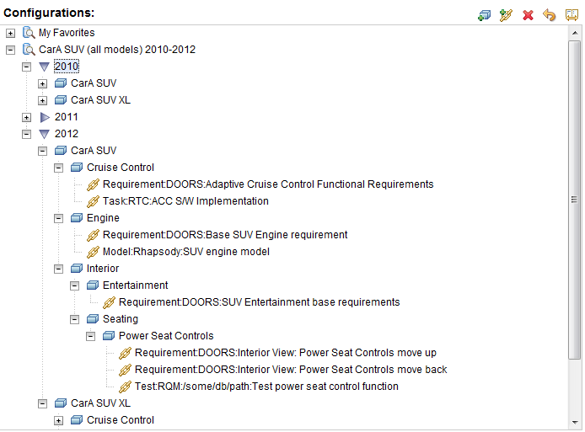
Product Configuration
Similar to a partial Bill-of-Materials
Imported from or integrated with existing PLE data

Slide 4
Product Context
Set product configuration context
Pass product context to other tools
Link resources/artifacts to the product context
Operations on the context, such as ‘make a baseline’

Slide 5
OSLC Requirements
Define a simple resource model for product configuration data (PLE)
Define a ‘product configuration’ model
Define a ‘product configuration context’
This is probably just the URI of some product resource
Define a way to communicate a product configuration context
e.g., in a URI, http header, or cookie

Slide 6
OSLC Requirements
Support OSLC Tracked Resource Sets (proposal currently in review)
Support baseline proposal (currently under development)

