Slide 1
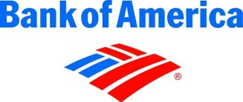
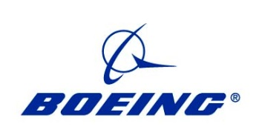
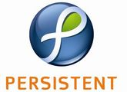
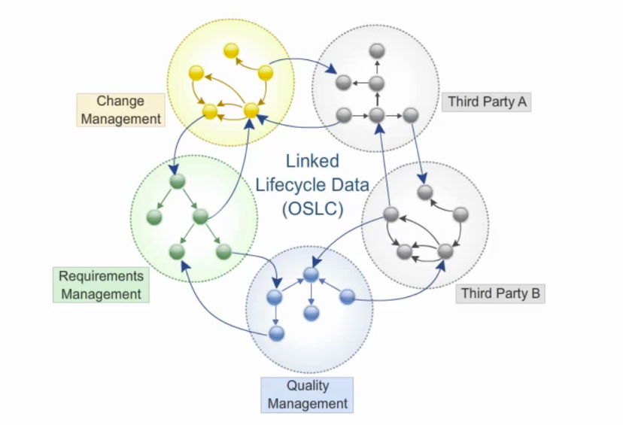
OSLC Member Section at OASIS
Open Services for Lifecycle Collaboration
Lifecycle integration inspired by the web
OASIS OSLC Co-Founders
Aspirations for OSLC
Foundational technology for integration
The household name for integrations
Natural choice for standardizing loosely-coupled integrations in new domains
The Technical Vision for OSLC
The Technical Vision for OSLC
Users can work seamlessly across their tools
(complex and fragile synchronization schemes not required)
Scenario-driven & Solution-oriented
Leading choice for strategic integration technology
Generally applicable: specs available for many domains covering ALM, DevOps, ISM, and PLM
Architecture of the Web
Standard Interfaces
Open Services for Lifecycle Collaboration
Lifecycle integration inspired by the web
Linked Data
Automation
“Just Enough” integration
Linked Data Platform Working Group
OSLC Member Section
Increased reuse
Monitoring
Increased traceability
Based on and Shaping the Future of Internet Architecture
Open and Independent Governance and Leadership
Decreased maintenance costs
Better visibility
The Resource for OSLC Implementers
OSLC is an open and scalable approach to lifecycle integration.
It simplifies key integration scenarios across heterogeneous tools
OSLC:
Inspired by the web
Proven
Free to use and share
Open
Changing the industry
Innovative

