Slide 1
Story 2
Preconditions – Step2.0
AMG54556/002 Top Level HSUVExample released and Open in Teamcenter Rich Client Requirements Manager

Slide 2
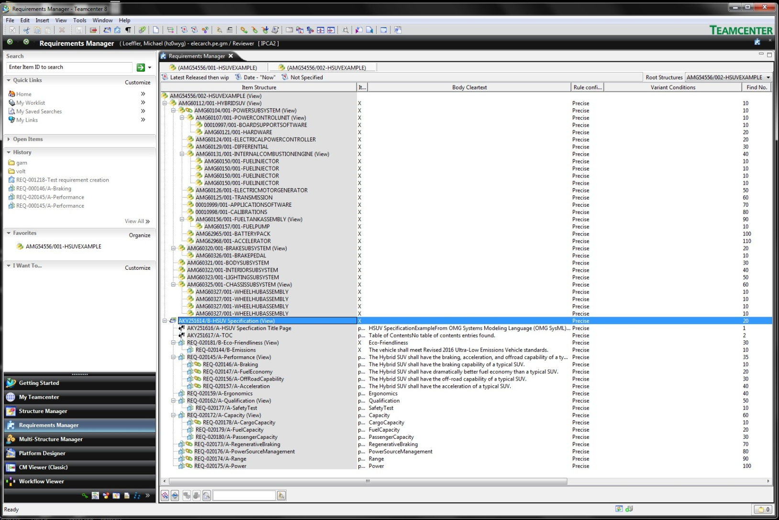
Preconditions – Step2.0 – Teamcenter View

Slide 3
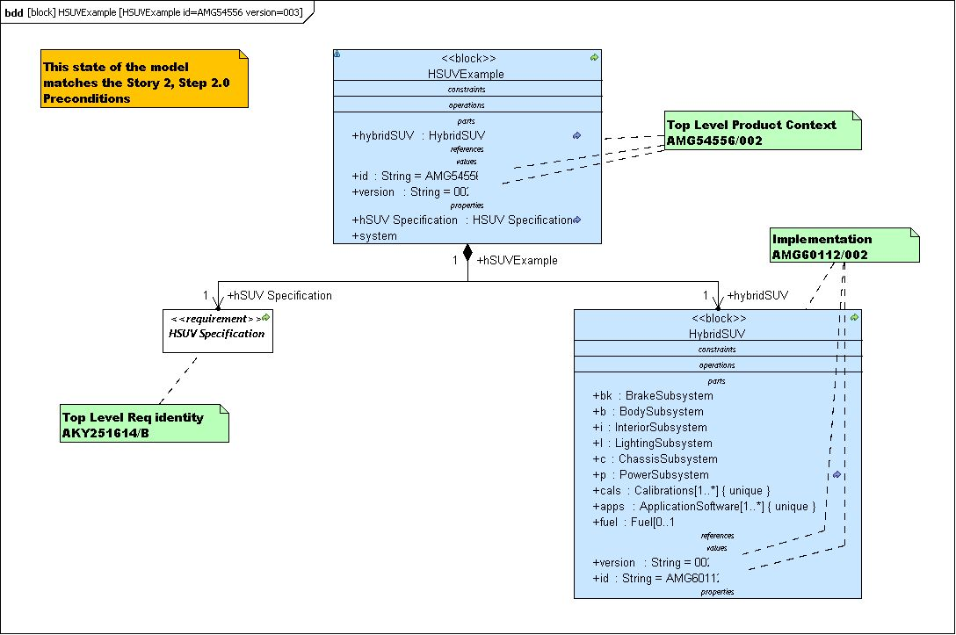
Preconditions – Step2.0 – Topcased Model View – Top Level Product (Context)

Slide 4
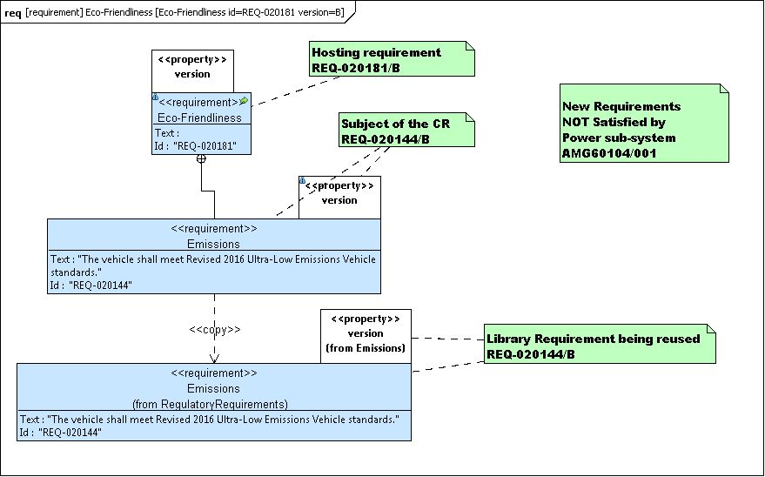
Preconditions – Step2.0 – Topcased Model View – Problem Item (Requirement)

Slide 5
Preconditions – Step2.0 – TBD ALM Requirements Client View

Slide 6
Story 2 Step2.1 – Change Requirements to Market in both US and EU Regions meeting 2016 ULEV - Marketing opens change request
  Need to change vehicle to meet Both US and EU 2016 ULEV standards
  Change request initiated at the top level of requirements to add multiple marketing region capability
  Change request has problem item AKY251614/B attached
  Change requester recognizes that Emissions requirements will be affected
  Change request has problem item REQ-020144/B attached
  Change request has reference item AMG54556/002 attached (this is the context, unconfigured for this step)

Slide 7
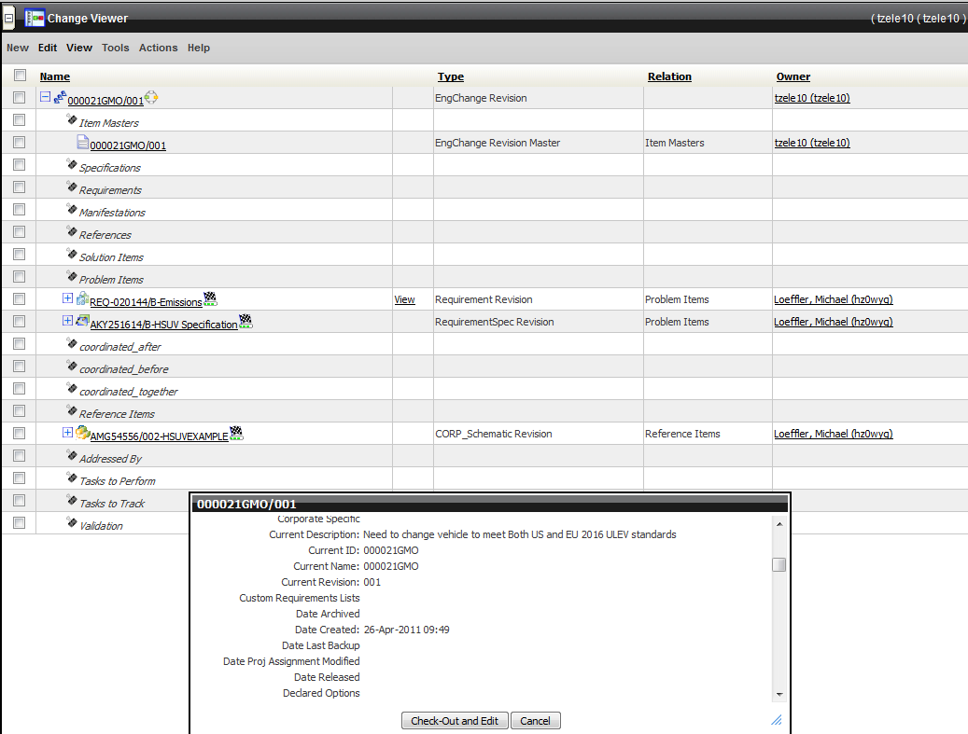
Story 2 Step2.1 – Teamcenter View

Slide 8
Story 1 Step2.1 – TBD ALM Requirements Client View

Slide 9
Story 2 Step 2.2 – Need to Add “Marketing Region” Requirement Under HSUV Specification Level
Revise top level HSUV Specification to allow editing, creating AKY251614/C
Revise top product and add options for EU and US Marketing Regions, create AMG54556/003
Insert new requirement under HSUV Specification, Marketing Region, REQ-020186/A
Insert two new sub-requirements under the Marketing Region requirement for the two regions, US and EU, REQ-020187/A and REQ-020188/A

Slide 10
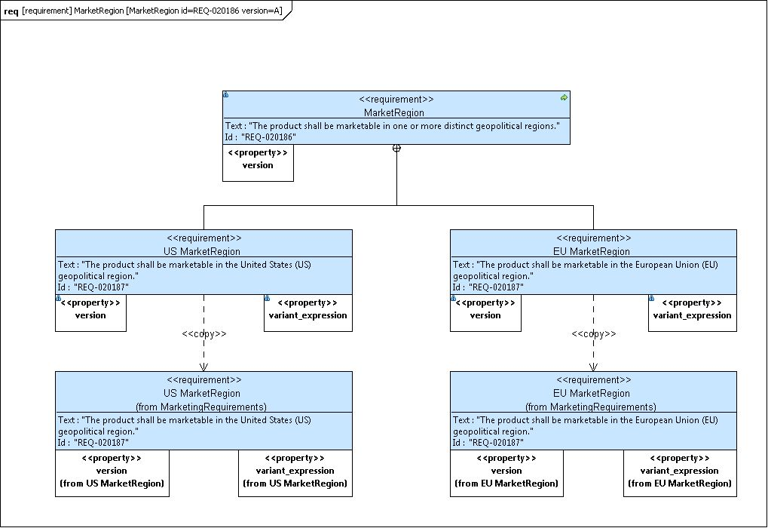
Story 2 Step 2.2 – Topcased Model View

Slide 11
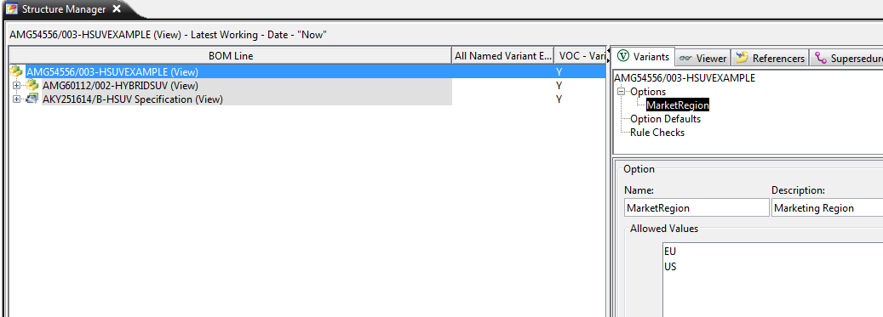
Story 2 Step 2.2 – Teamcenter View of Adding Options

Slide 12
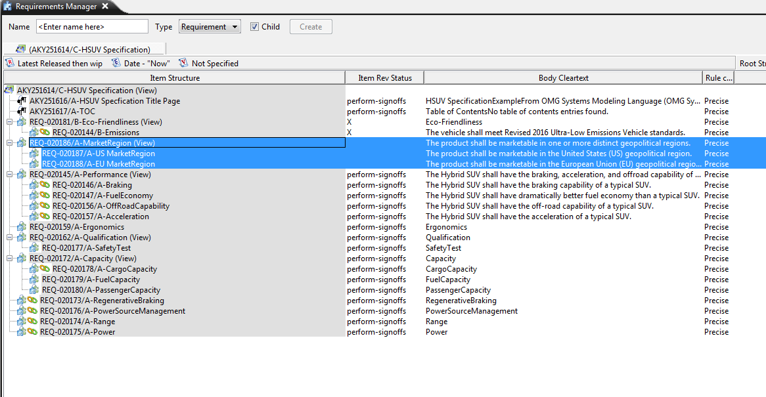
Story 2 Step 2.2 – Teamcenter View of Adding New Requirements

Slide 13
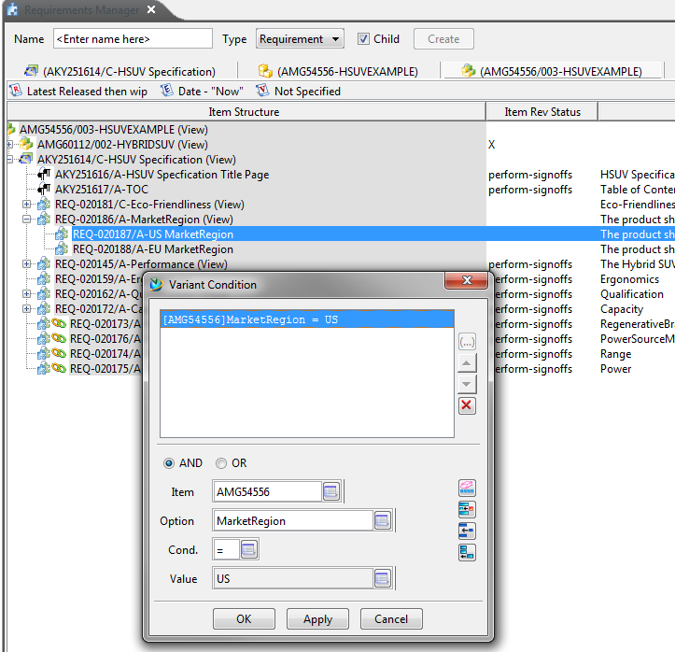
Story 2 Step 2.2 – Teamcenter View of Adding US Variant Condition

Slide 14
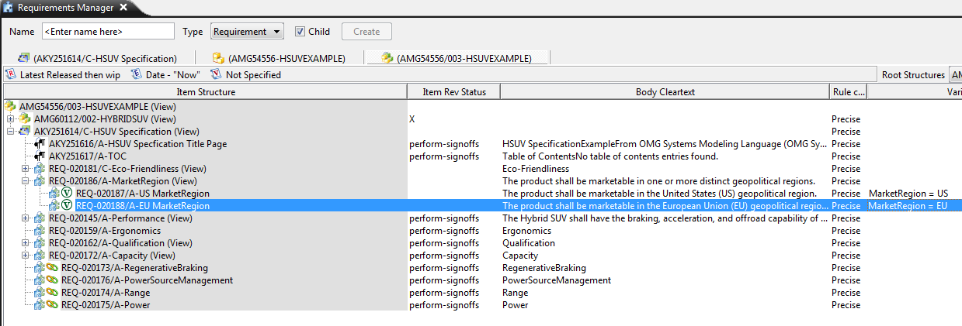
Story 2 Step 2.2 – Teamcenter View of Variants Added

Slide 15
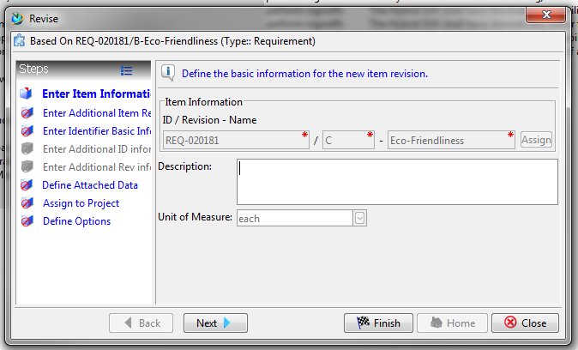
Story 2 Step2.3
Released REQ-020181/B is revised to begin work on version “C”
Teamcenter View

Slide 16
Story 2 Step 2.4 - New Requirements Needed to Meet the US and EU Marketing Region ULEV Regulations
Similar to region non-specific 2016 ULEV requirement
Create new library reusable requirements and make copies to this product per SysML standard mechanism, REQ-020184/A and REQ-020185/A
Add deriveReqt trace link from new emissions requirements to new market region requirements.
Add variant conditions to new requirements in context of top level (may be unnecessary if variants on marketing region carry through derive requirement relationship)

Slide 17
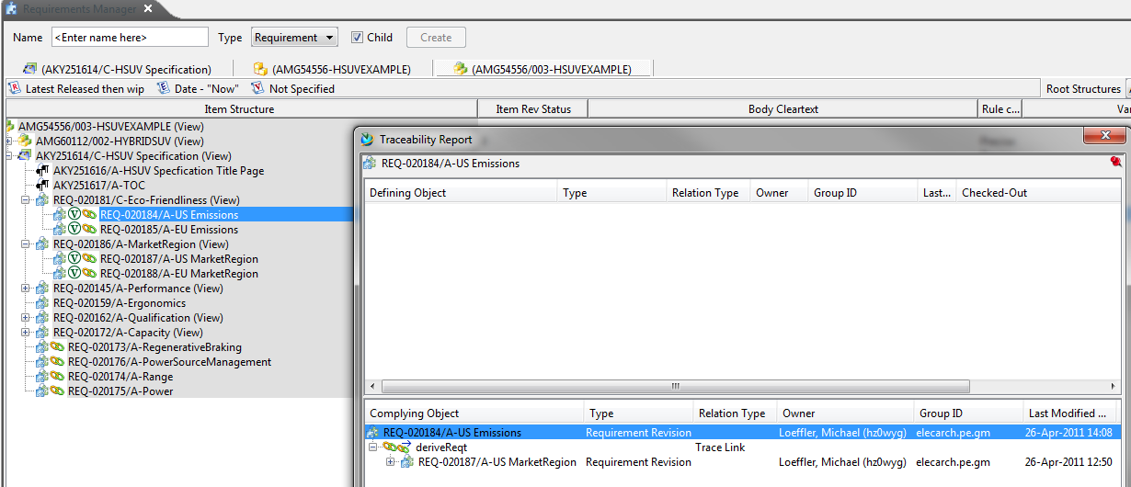
Story 2 Step 2.4 – Teamcenter View

Slide 18
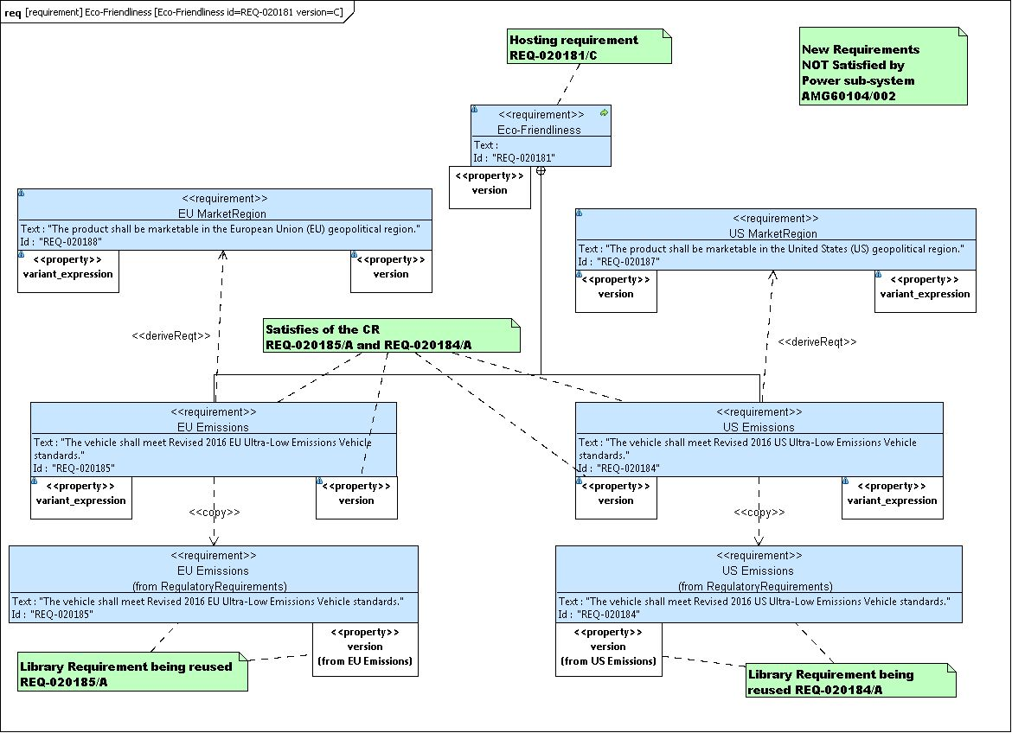
Step 2.4 –Topcased Model View

Slide 19
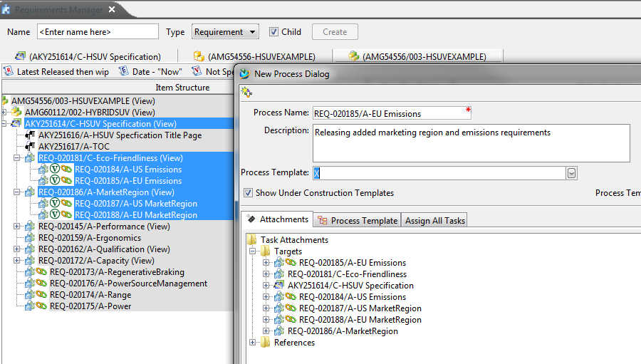
Story 2 Step2.5
When all requirements add/changes are complete they are all released up to the HSUV Specification (AKY251614/C, REQ-020181/C, REQ-020184/A, REQ-020185/C, REQ-020186/A, REQ-020187/A, REQ-020188/A)

Slide 20
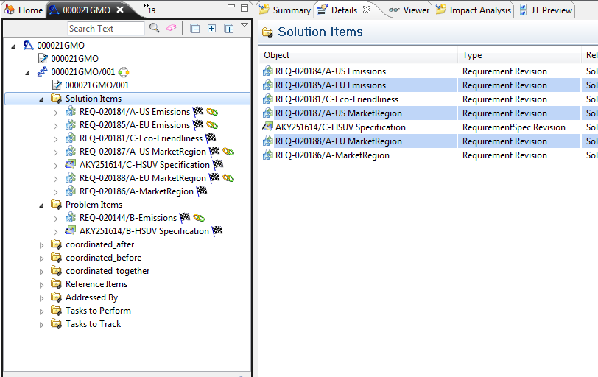
Story 2 Step2.6
When all new requirements are released, add them to the change request (000021GMO/001) as Solution Items

Slide 21
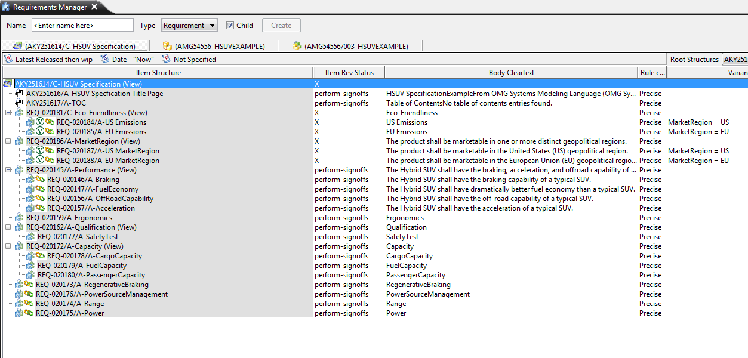
Story 2 Requirements Steps Postcondition
Released requirements context now has AMG54556/003, AKY251614/C, REQ-020181/C, REQ-020184/A, REQ-020185/A, REQ-020186/A, REQ-020187/A, REQ-020188/A, rest are not changed

Slide 22
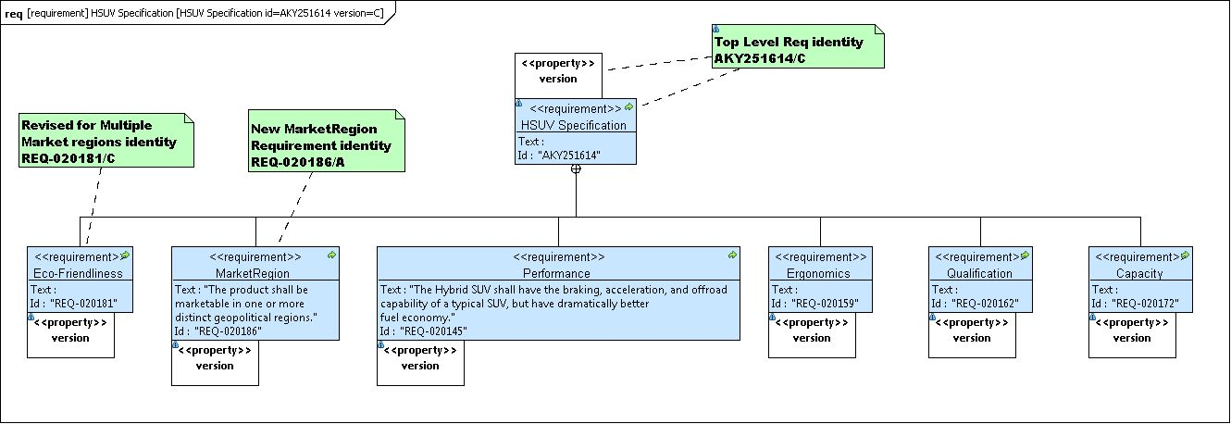
Story 2 Requirements Steps Postcondition
Topcased HSUV Specification AKV251614/C With MarketRegion Requirement Added

Slide 23
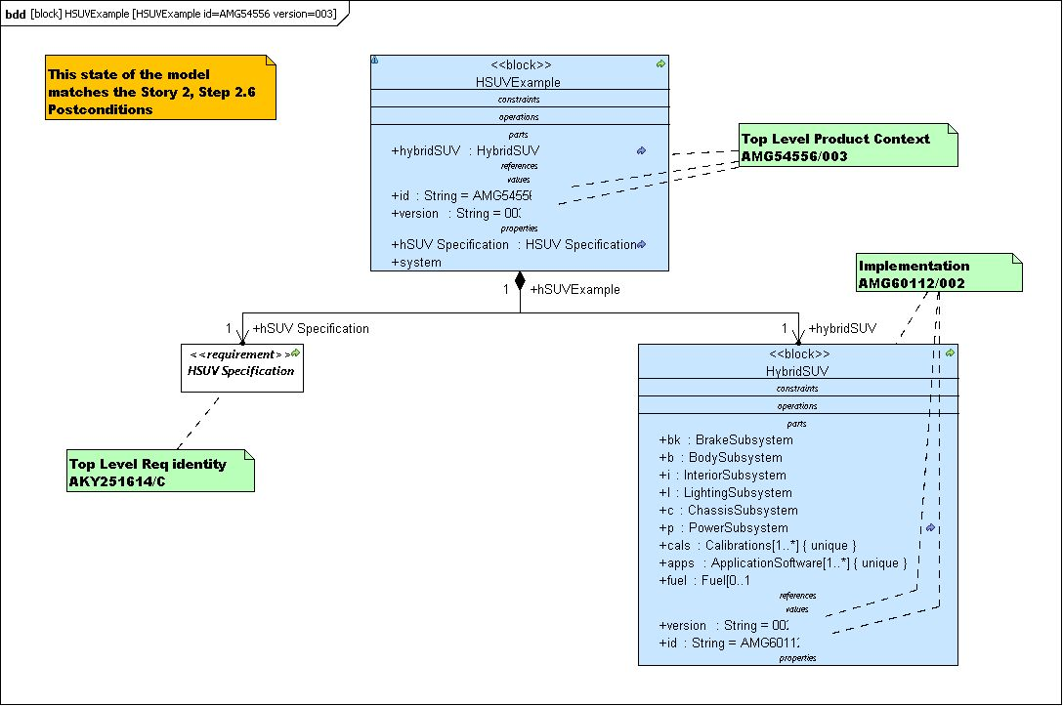
Story 1 Requirements Steps Postcondition
Topcased top level context HSUVExample AMG54559/003

Slide 24
Story 2 Step3.0
Original change request remains open, related structure items must be fixed to meet the revised requirement
Follow the <<satisfy>> link in AMG54556/002 from REQ-000144/B to find PowerSubsystem AMG60104/002, add it to the list of problem items on the change request, add the top level HybridSUV (AMG60112/002) item as reference
Revise released AMG60104/002 to version 003 and begin changes to meet new requirement

Slide 25
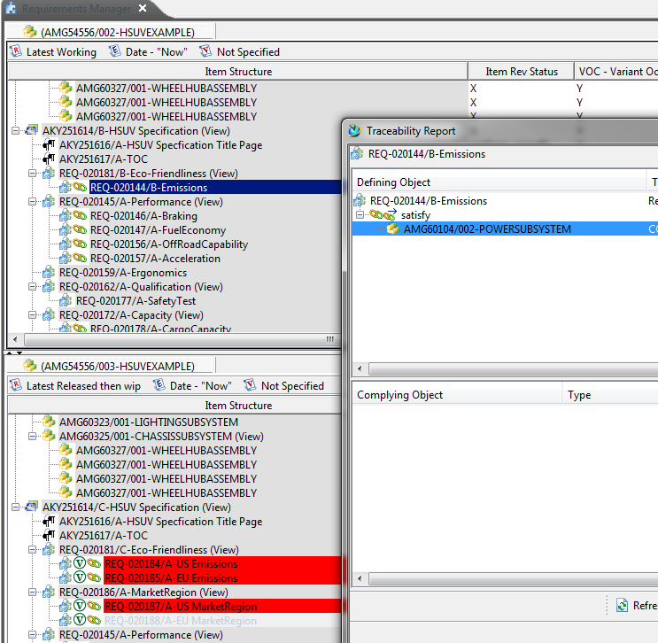
Story 2 Step 3.0
Teamcenter Compare Specs and Follow Satisfy Link

Slide 26
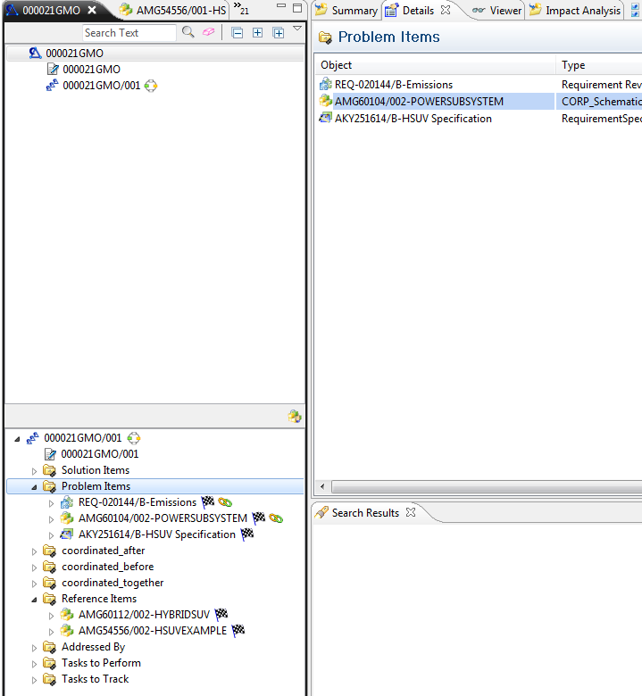
Story 2 Step 3.0
Teamcenter Add AMG060104/002 as Problem Item and AMG60112/002 as Reference Item

Slide 27
Story 2 Step3.1
Create new versions of PowerControlUnit, Hardware, BoardSupportSoftware, FuelTankAssembly, ApplicationSoftware and Calibrations to meet new requirement
Attach each original version to the change request as problem items (NOTE: This could have been done when the initial change request was created by following the links from the requirement that was attached)
Attach the revised versions as solution items
NOTE: ApplicationSoftware and Calibrations should probably be further decomposed and the change should roll down to internal items inside them, such as a specific version of a specific software component, etc. to illustrate the ALM connectivity to the context

Slide 28
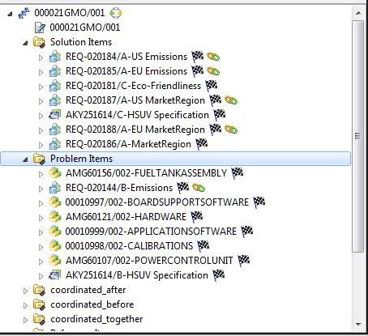
Story 2 Step3.1
Teamcenter View – Added Problem Items

Slide 29
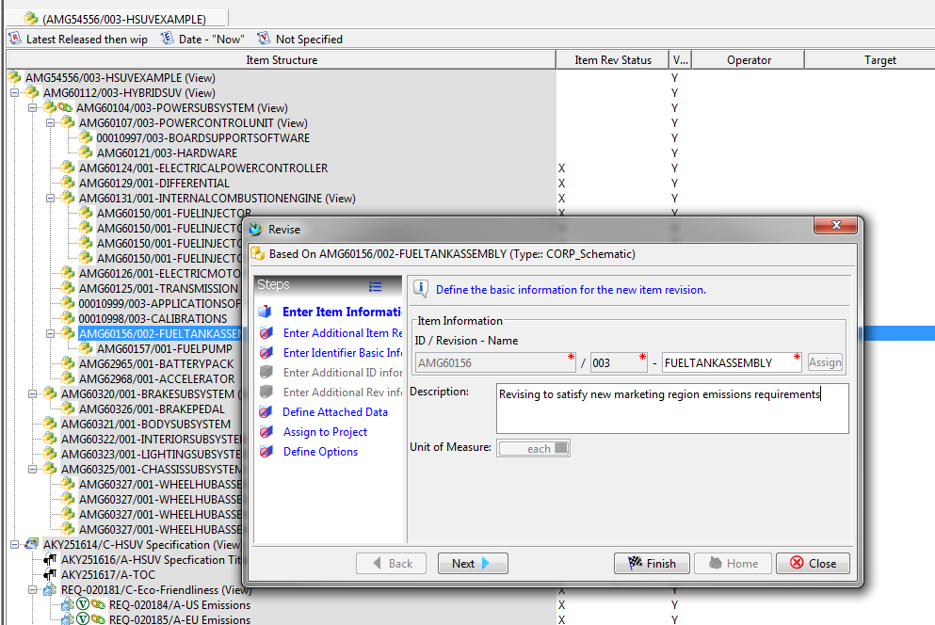
Story 2 Step3.1
Teamcenter View – New Version

Slide 30
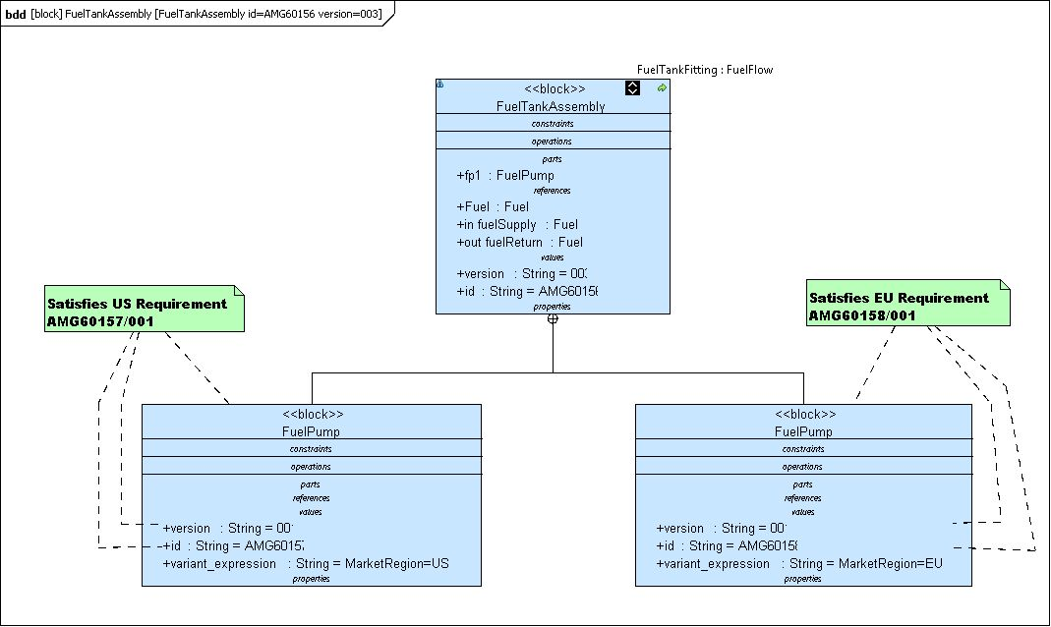
Story 2 Step3.1
Topcased View – Second Fuel Pump Variant Added

Slide 31
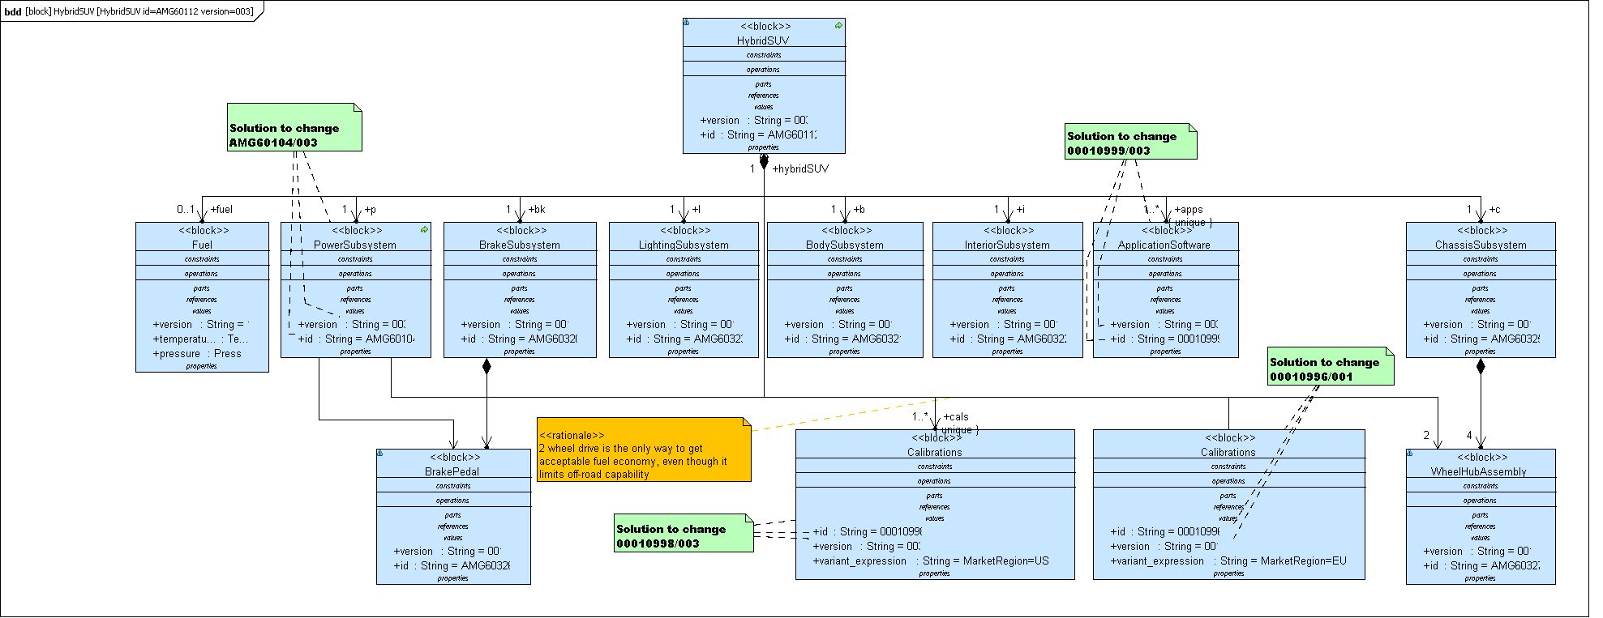
Story 2 Step3.1
Topcased View – Second Calibration Variant Added

Slide 32
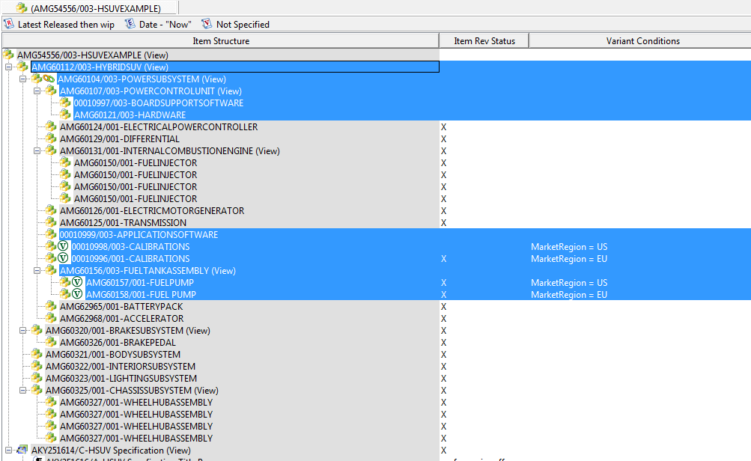
Story 2 Step3.1
Teamcenter View – New Versions of Problem Items with Variant Conditions Added

Slide 33
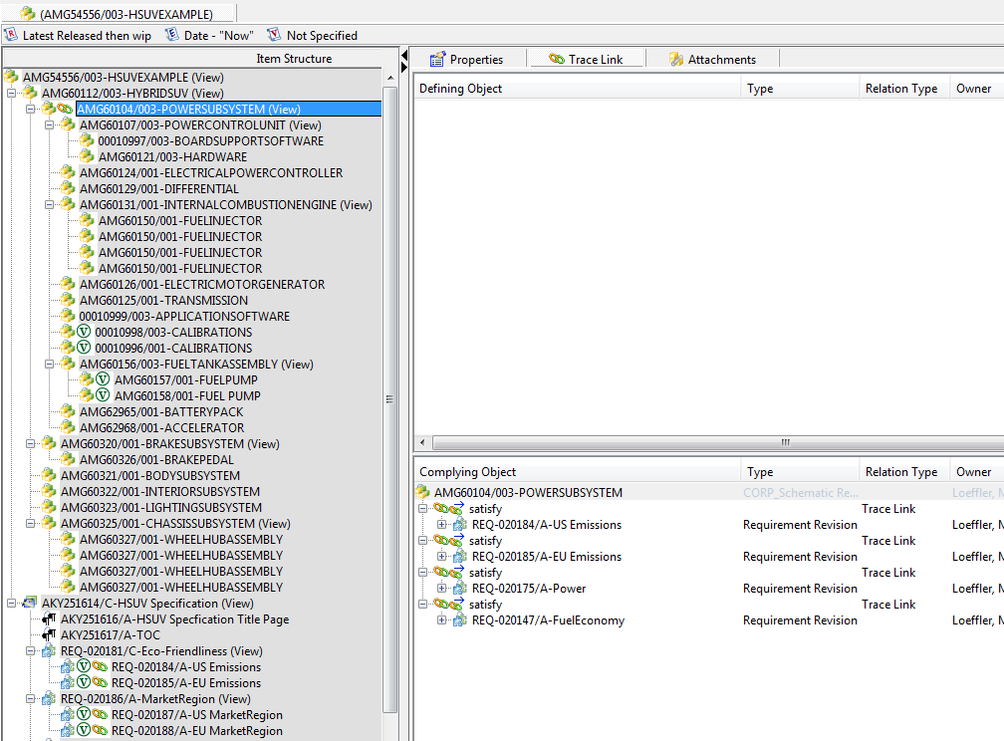
Story 2 Step3.2
Correct All Trace Relations

Slide 34
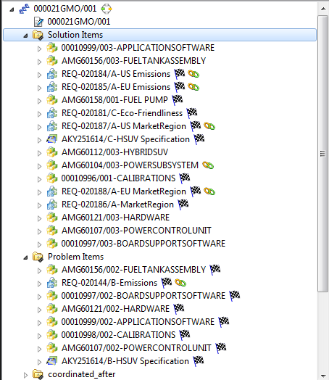
Story 2 Step3.3
Add Solution Items to Change Request

Slide 35
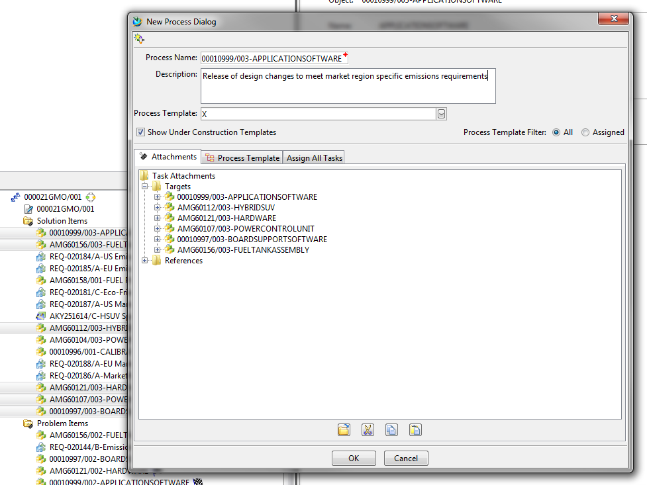
Story 2 Step3.4
Release all the new versions, up through HybridSUV

Slide 36
Story 2 Step3.5
Close the change request as complete
This step may be automatic based on how the change request system is configured to handle closing of the change based on release of the solution items.

Slide 37
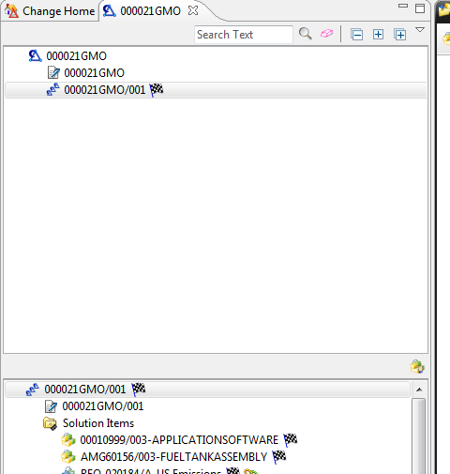
Story 2 Step3.5 Postcondition
Teamcenter View - Close the change request as complete

